Slide 1

Introduction to Computer Mutex
Professor : Jake Tarn
Lecturer: Sunny

Slide 2
Mutual Exclusion
xSemaphoreCreateMutex()
SemaphoreHandle_t xSemaphoreCreateMutex( void );
The Gate Keeper

Slide 3
Mutex Exclusion

Slide 4
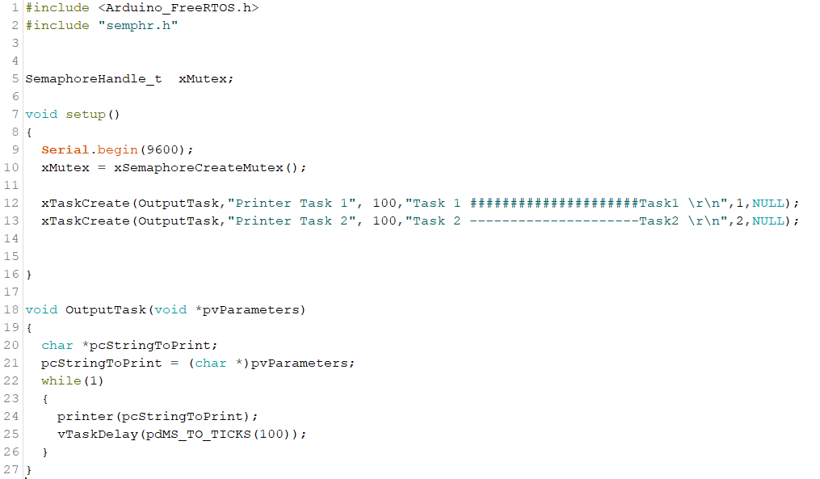

Slide 5
